Slide 1

HTTP Headers
HTTP headers are metadata sent between a client (browser) and server during web communication. They contain information about the request/response, like content type, authentication, caching rules, and security policies.

Slide 2

SECURITY ESSENTIALS
What Are Security HTTP Headers?
Security HTTP headers are special instructions that protect users and websites from common attacks. They don't fix bad code, but they reduce damage and block entire classes of attacks.
Think of them as an additional defense layer that works alongside your application security.

Slide 3
Key Security Headers
Content-Security-Policy
X-Frame-Options
Strict-Transport-Security
Prevents XSS attacks by controlling which resources can load on your site.
Stops clickjacking by preventing your site from being embedded in iframes.
Forces HTTPS connections to ensure secure communication.

Slide 4

More Essential Headers
X-Content-Type-Options
Referrer-Policy
Prevents MIME-type sniffing attacks by ensuring browsers respect declared content types.
Controls what information is sent in the Referer header to protect user privacy.

Slide 5
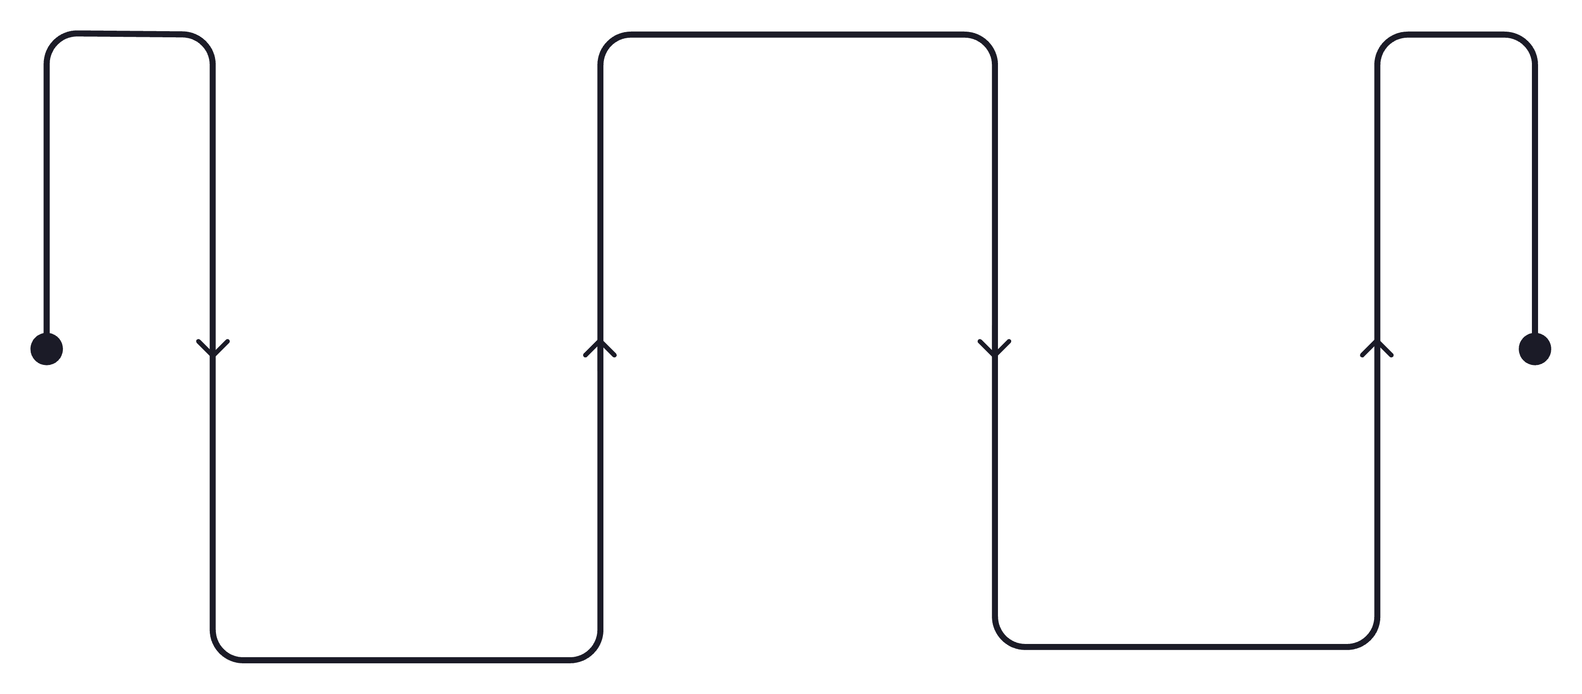
Why Security Headers Matter
Enforce Protocols
Require secure headers and TLS
Mitigate Vectors
Reduce Surface
Block common attack methods
Minimize exposed resources
Security headers act as an additional defense layer that protects your application even when other vulnerabilities exist. They provide comprehensive protection across multiple threat categories.

Slide 6


CRITICAL RISKS
Cross-Site Scripting (XSS)
The Threat
Without proper headers like Content-Security-Policy, attackers can inject malicious scripts into your website. These scripts can steal user data, hijack sessions, or deface your site.
The Protection
CSP headers define trusted sources for scripts, styles, and other resources, blocking unauthorized code execution.

Slide 7

Clickjacking Attacks
How It Works
Attackers embed your site in a hidden iframe and trick users into clicking elements they can't see.
The Defense
X-Frame-Options header prevents your site from being loaded in frames, eliminating this attack vector entirely.

Slide 8


Man-in-the-Middle Attacks
Insecure Connections
Forced HTTPS
Without HSTS, attackers can intercept data on insecure HTTP connections.
Strict-Transport-Security header ensures all connections use encrypted HTTPS.

Slide 9


Additional Vulnerabilities
Data Leakage
Content Injection
Sensitive information exposed through referrers without proper Referrer-Policy.
Unauthorized resources loaded on your pages without X-Content-Type-Options protection.

Slide 10

Protect Your Website
Implement all five critical security headers
CSP, X-Frame-Options, HSTS, X-Content-Type-Options, and Referrer-Policy
Test your configuration regularly
Use security scanning tools to verify headers are properly set
Stay updated on emerging threats
Security best practices evolve—keep your defenses current

